Slide 1
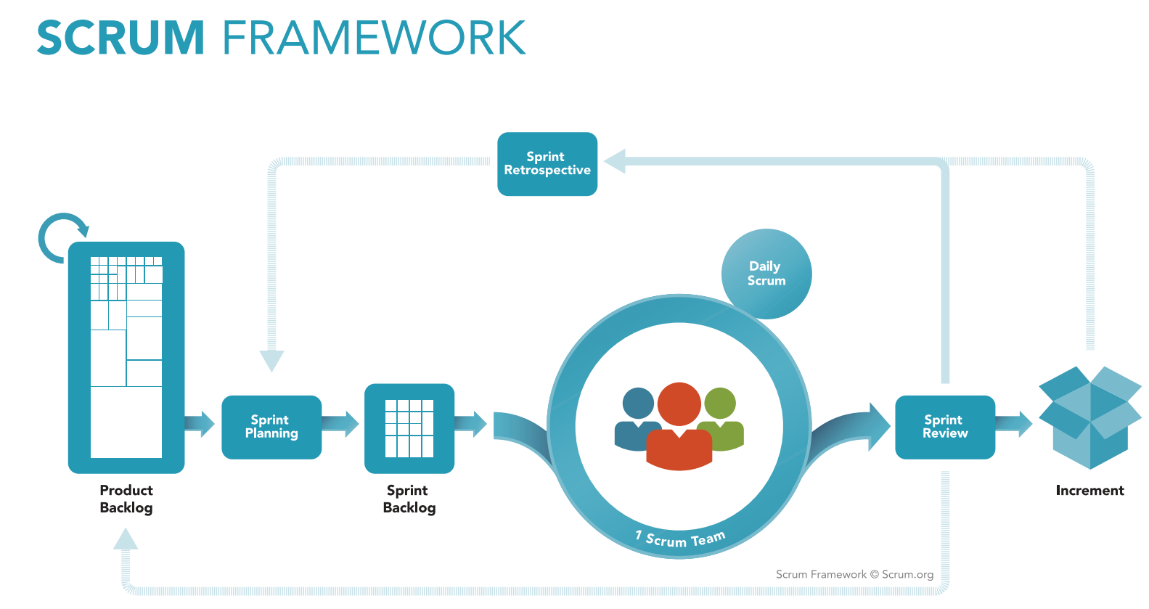
The Product Owner is responsible for the Product Backlog, including its content, availability, and ordering. List of requirements. It evolves as the product and the environment in which it will be used evolves. The Product Backlog is dynamic; it constantly changes to identify what the product needs to be appropriate, competitive, and useful.
Divide all the requirements into Sprints.
https://www.scrum.org/resources/what-is-scrum

Slide 2
What can be delivered in the Increment resulting from the upcoming Sprint?
https://www.scrum.org/resources/what-is-scrum

Slide 3
The Sprint Backlog is a plan with enough detail that changes in progress can be understood in the Daily Scrum. The Development Team modifies the Sprint Backlog throughout the Sprint.
The Sprint Backlog is a highly visible, real-time picture of the work that the Development Team plans to accomplish during the Sprint, and it belongs solely to the Development Team.
https://www.scrum.org/resources/what-is-scrum

Slide 4
Meetings every week to know each others problems during the sprint and to help each other if needed.
https://www.scrum.org/resources/what-is-scrum

Slide 5
The Sprint Review includes the following elements:
What Product Backlog items have been “Done” and what has not been “Done”; discusses what went well during the Sprint, what problems it ran into, and how those problems were solved; The Product Owner discusses the Product Backlog as it stands. The entire group collaborates on what to do next, so that the Sprint Review provides valuable input to subsequent Sprint Planning;
Review of how the marketplace or potential use of the product might have changed what is the most valuable thing to do next; and,
Review of the timeline, budget, potential capabilities, and marketplace for the next anticipated releases of functionality and capability of the product.
https://www.scrum.org/resources/what-is-scrum

Slide 6
During the Sprint Retrospective, the team discusses:
What went well in the Sprint
What could be improved
What will we commit to improve in the next Sprint
The team should have identified improvements that it will implement in the next Sprint.
Although improvements may be implemented at any time, the Sprint Retrospective provides a formal opportunity to focus on inspection and adaptation.
https://www.scrum.org/resources/what-is-scrum

Slide 7
Final product
https://www.scrum.org/resources/what-is-scrum

